Slide 1
Equine Diseases
(Strangles)
Post Mortem
Assistant Professor
Dr. Jihad A. Ahmed
College of Veterinary Medicine / University of Basrah

Slide 2
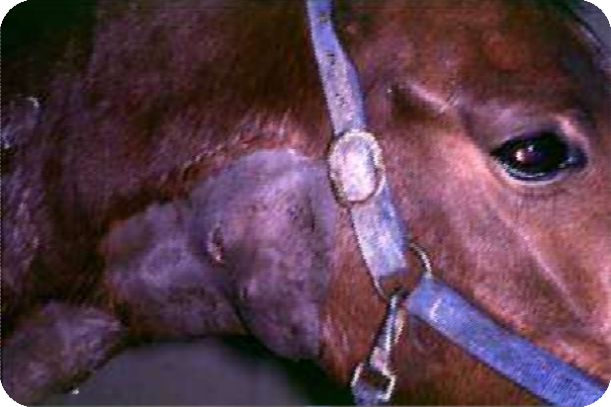

Strangles
Acute infectious disease of horses - Equine
distemper
Caused by the bacterium Streptococcus equi sub-species equi (S. equi)
Characterized by abscess in pharyngeal and maxillary LN, pericarditis, pleuritis, suppurative pneumonia, presence of abscesses on liver, kidney and spleen.
Andrew S.Waller et al.,

Slide 3
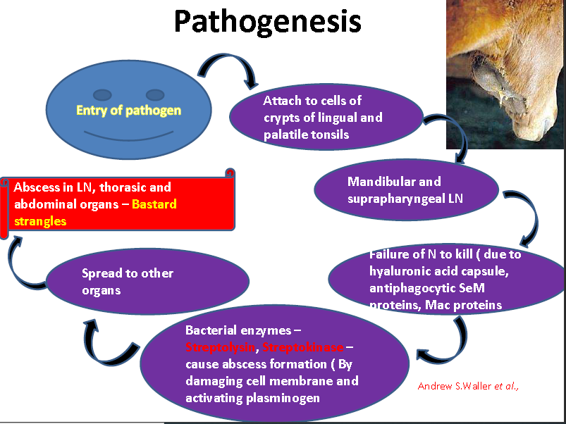

Slide 4
Guttural pouch empyema
LN swell, abscess and rupture either externally through the horse’s skin
In retropharyngeal LN, usually internally into the guttural pouch.
This air-filled sack is an enlargement of the eustachian tube that drains
into the nasal cavity.
Drainage of abscess material into the nasal cavity from the guttural pouch contributes to the mucopurulent nasal discharges commonly observed during strangles.
Residual pus becomes inspissated to form chondroids

Slide 5
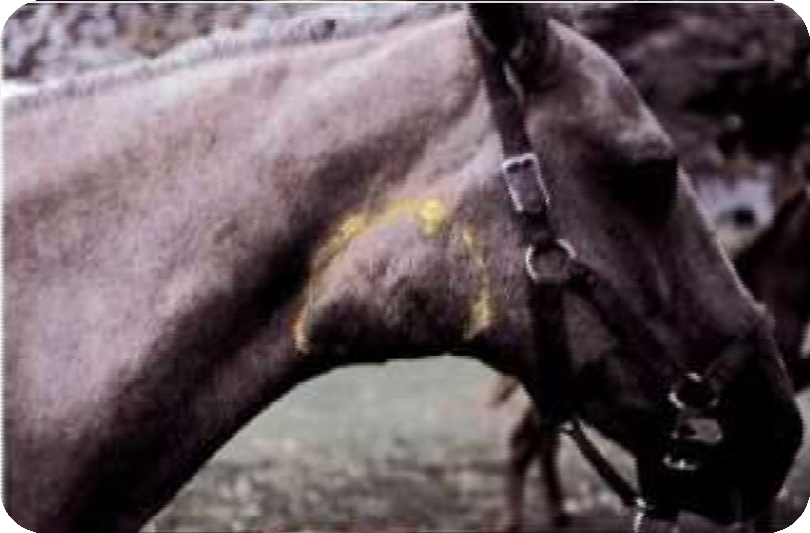
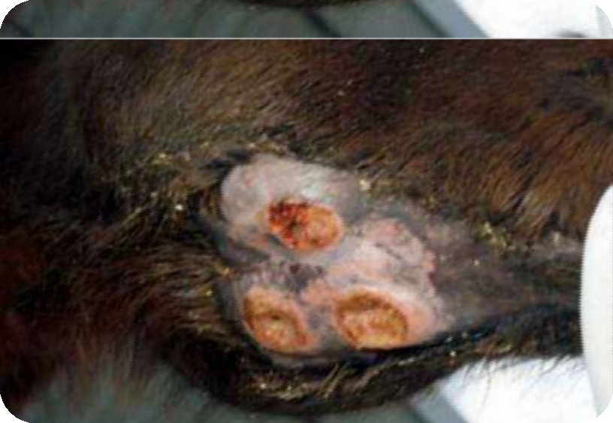


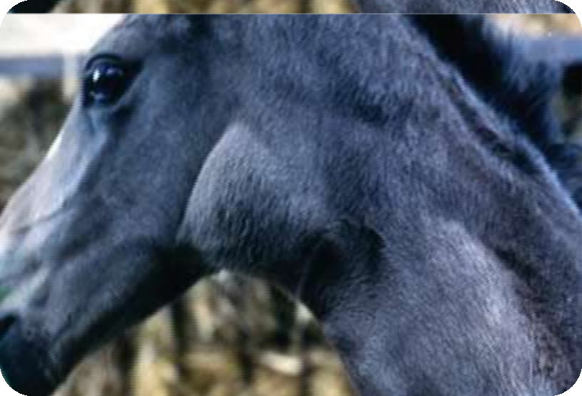

Rupture of submandibular abscess
Edematous swelling of pharyngeal region

Slide 6
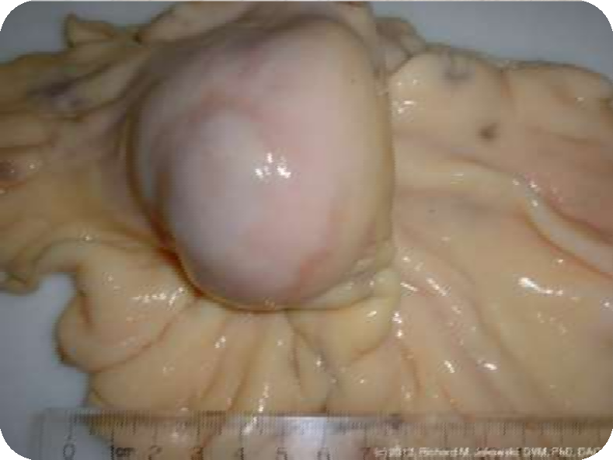
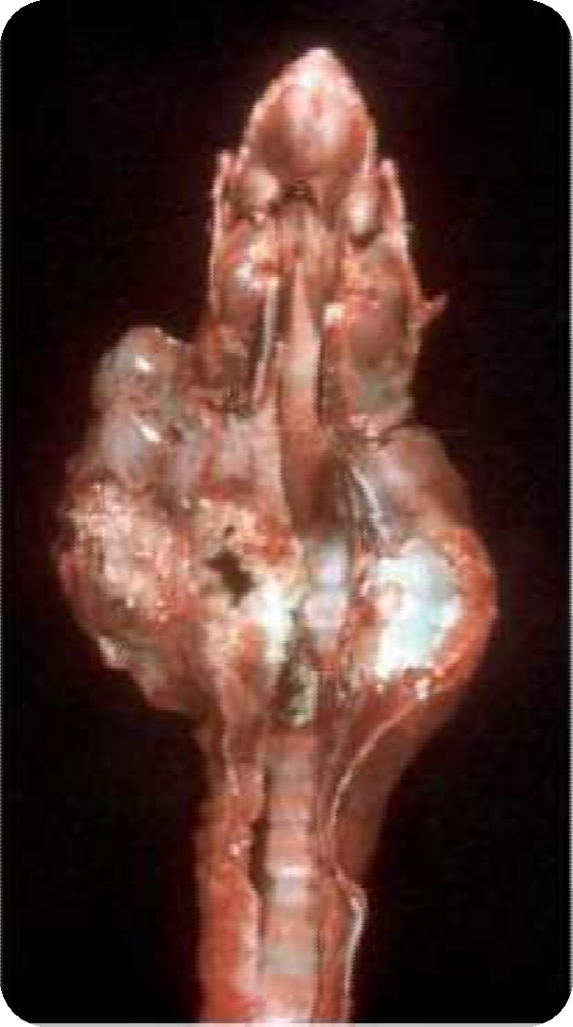

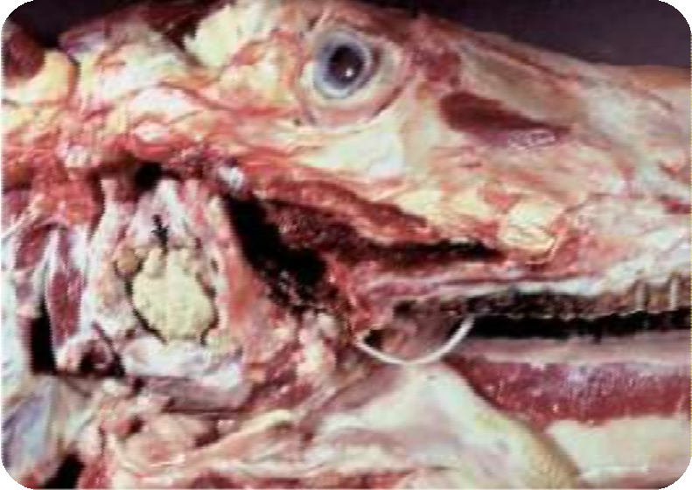


Bastard strangles – mesentric LN
Acute suppurative lymphadenitis
Guttural pouch empyema

Slide 7
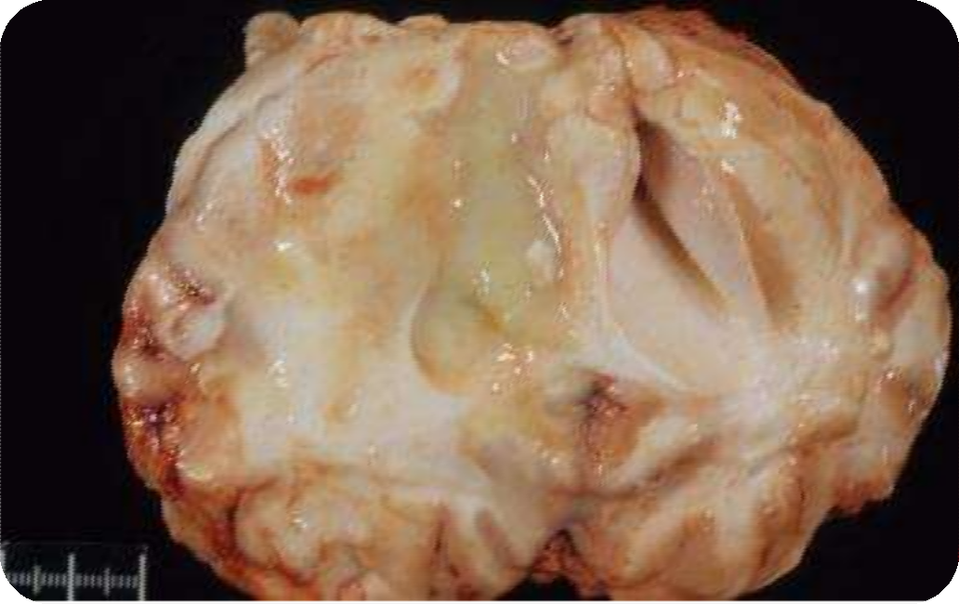

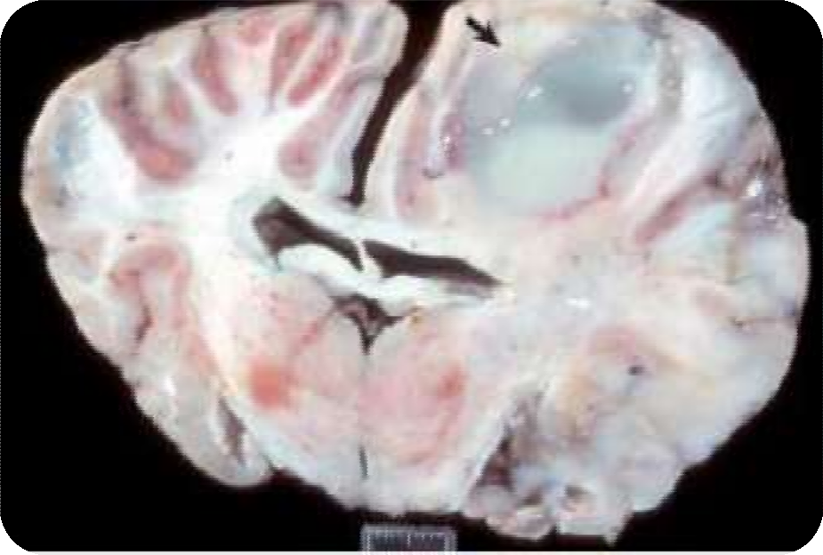
Metastatic abscess (brain)

Slide 8
Thank You

